Slide 1

HTML/CSS
Week 1-2
Nynne Christoffersen
Majd Darraj

Slide 3
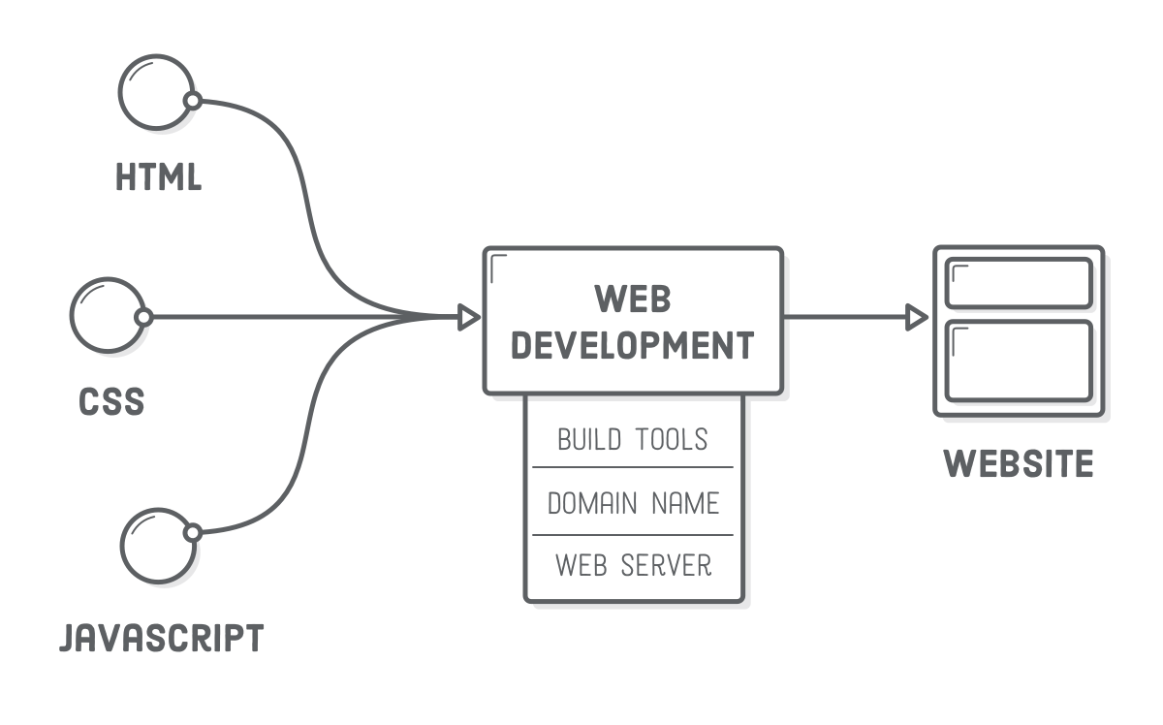
Web Development

Slide 4
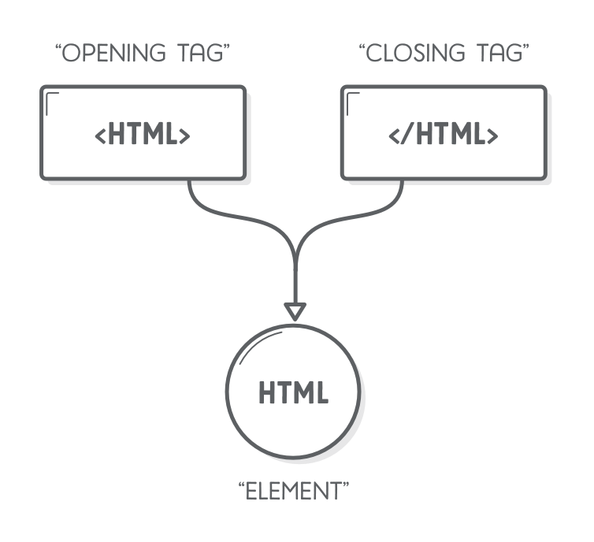
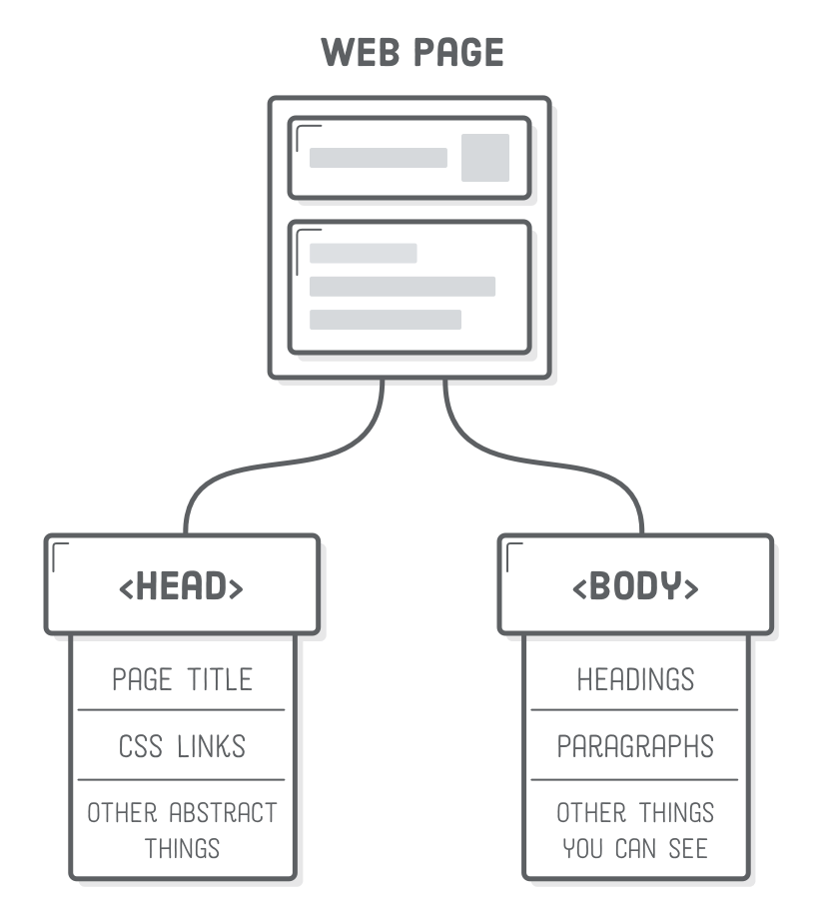
Web page structure

Slide 5
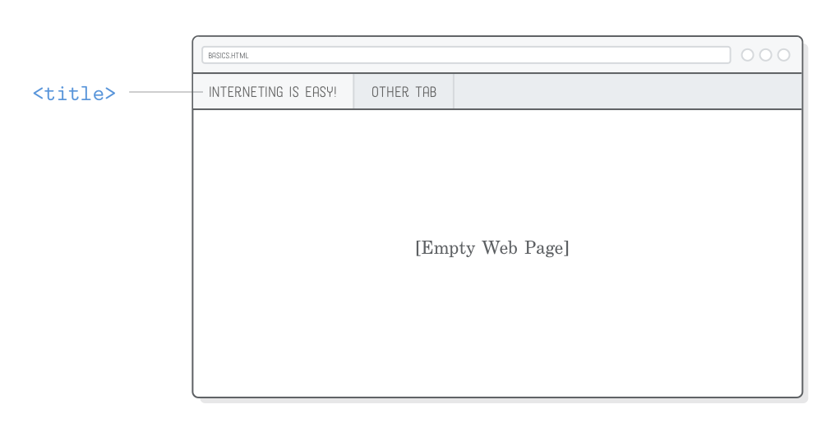
Head: <title>

Slide 6
“ Code is like humor. When you have to explain it, it’s bad.”

Slide 7
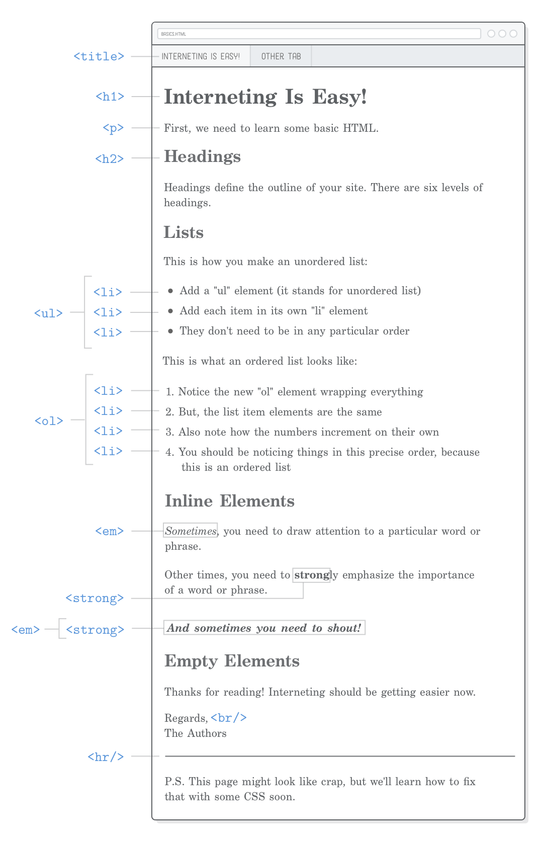
HTML elements

Slide 9

Document
Object
Model
Describe relationships in HTML
Browsers reads and organize HTML as a DOM
Every element is a Node in the DOM

Slide 10
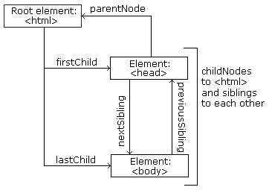
Each HTML element (node) has different relationships
Parent
<html> is the parent of <head> and <body>
<head> is the first child of <html>
<body> is the last child of <html>
Child
Sibling

Slide 11
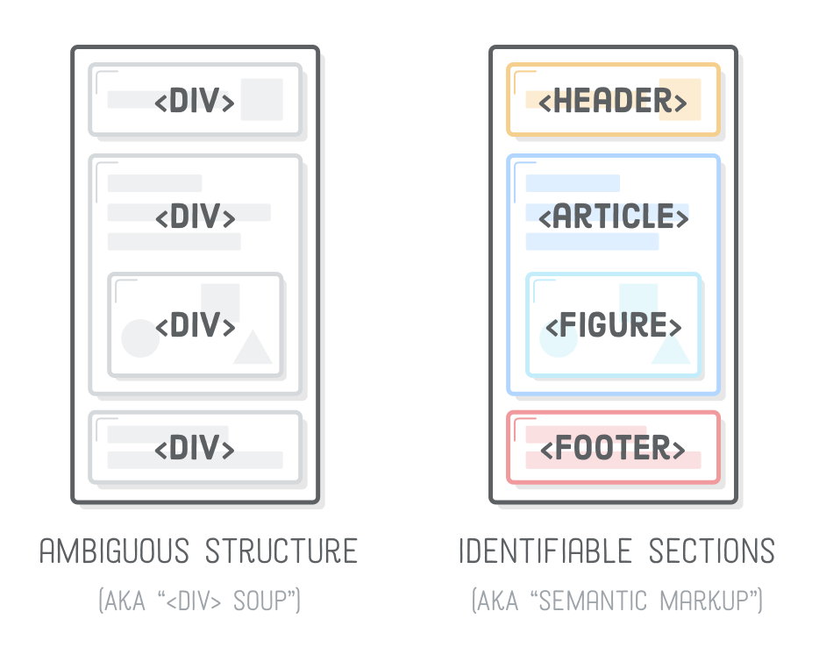
HTML Semantic Elements
For search engines
Semantic tags helps them quickly identify the structure of your entire website, making it easier to discover other pages.

Slide 12
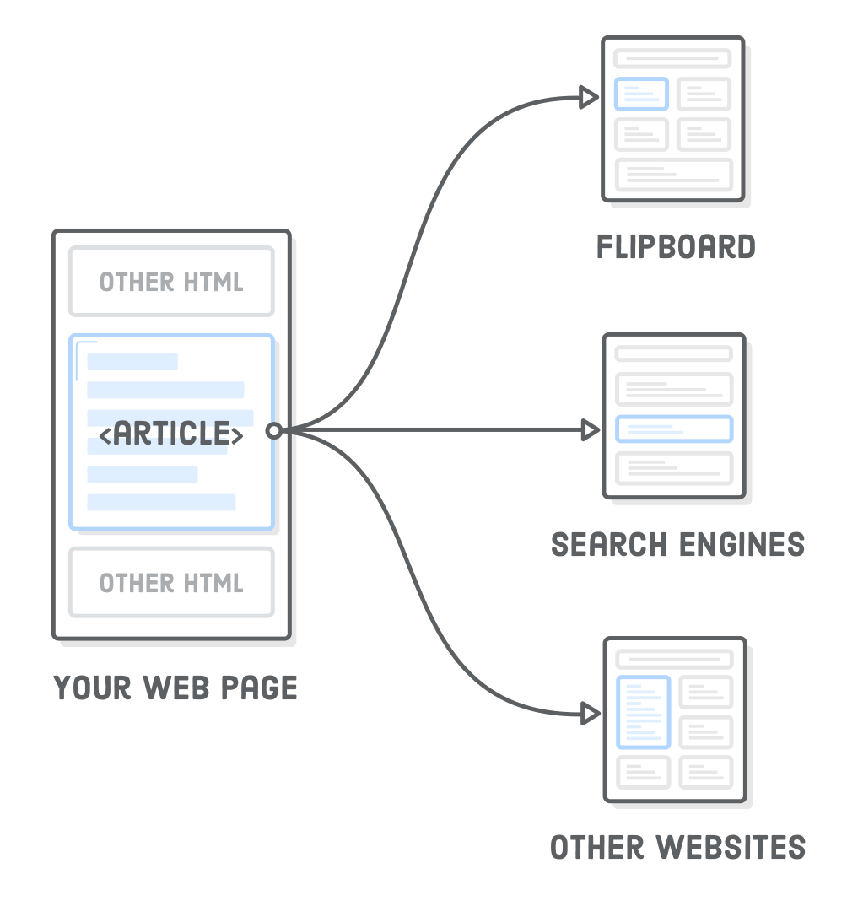
<article>
The <article> element represents an independent article in a web page
article CAN be taken out of the page and keep it’s context
used in blog posts, newspaper articles, or web pages dedicated to a single topic
For the cv example we should wrap all the content

Slide 13
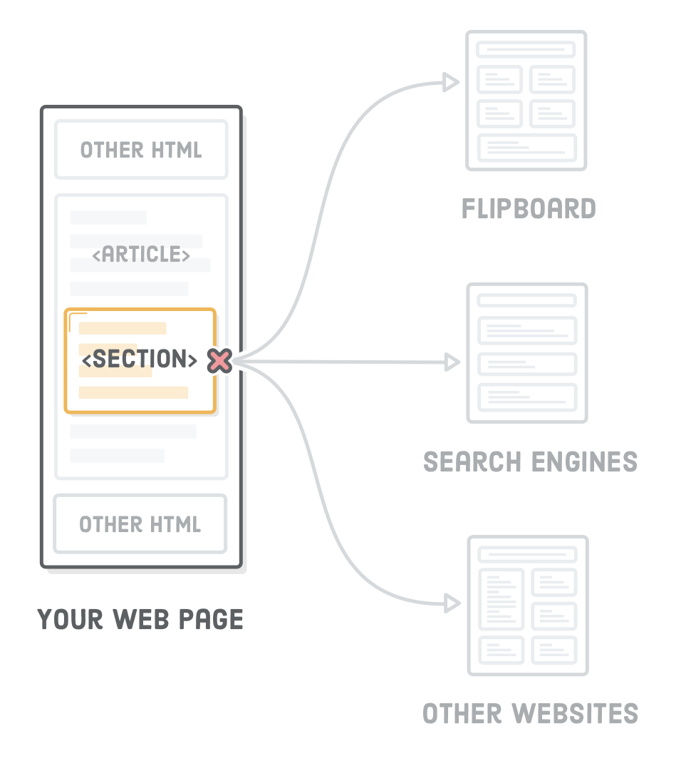
<section>
Like article it wraps a context but it doesn’t need to make sense outside the context of the page
<section> is more descriptive <section>element over a generic <div>
Each section should have at least one heading <h1> to <h6> elements
use <section> only as a replacement for container <div>’s when appropriate.

Slide 14
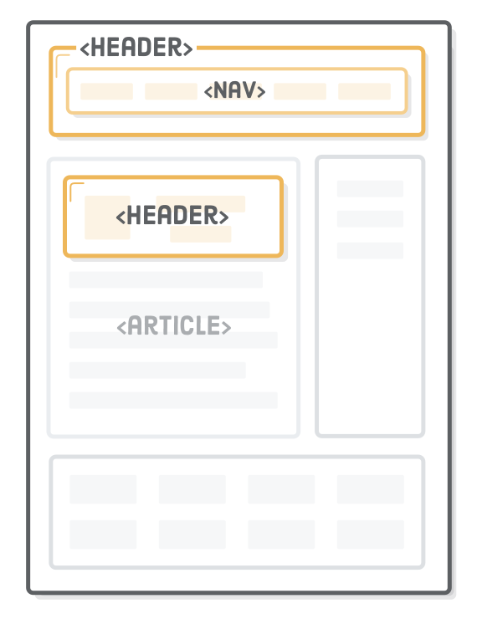
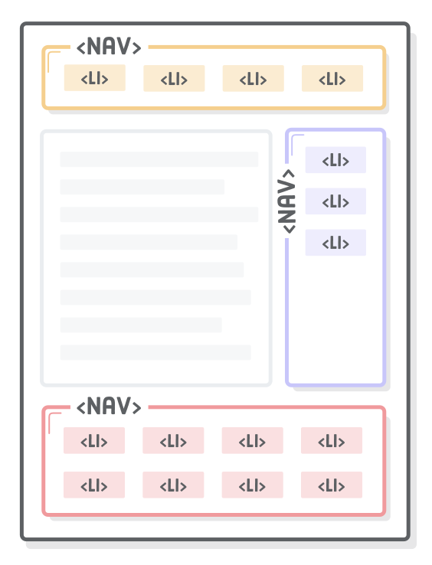
It denotes introductory content for a section, article, or entire web page
mark up the various navigation sections of your website

Slide 15
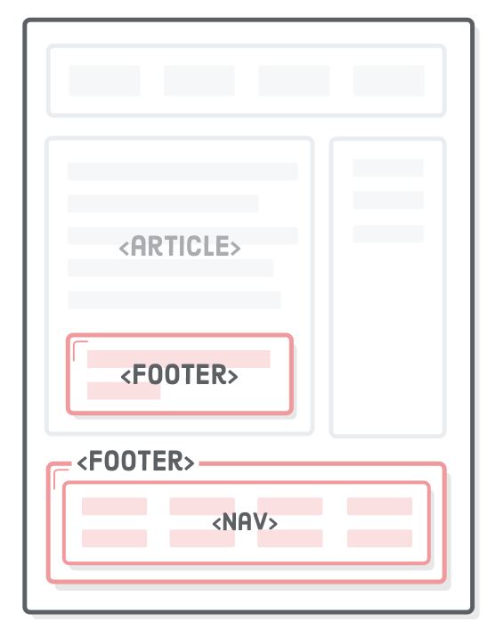
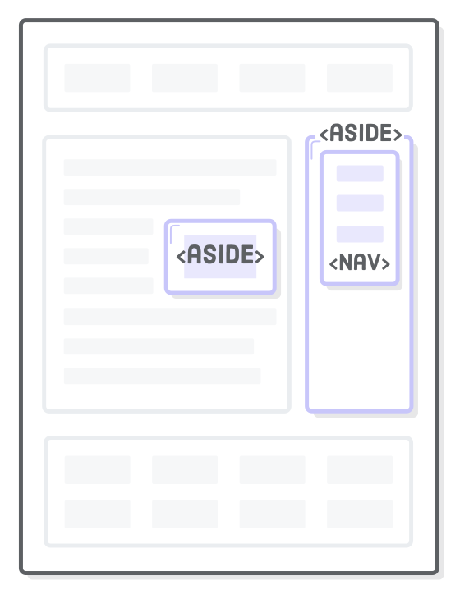
copyright notices, footer navigation, and author bios at the end of blog posts
sponsored blog post might contain an advertisement about the sponsoring company

Slide 16
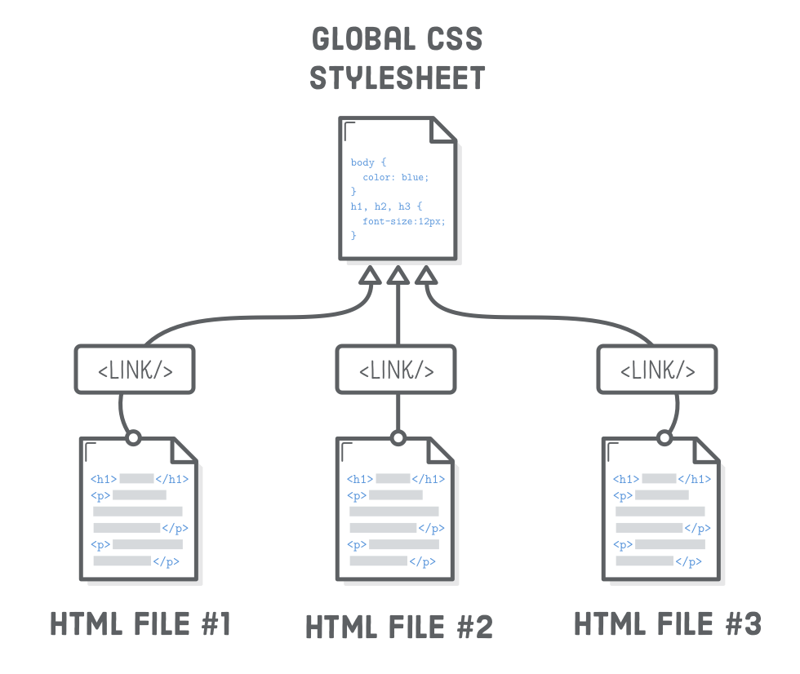
CSS is reusable

Slide 17
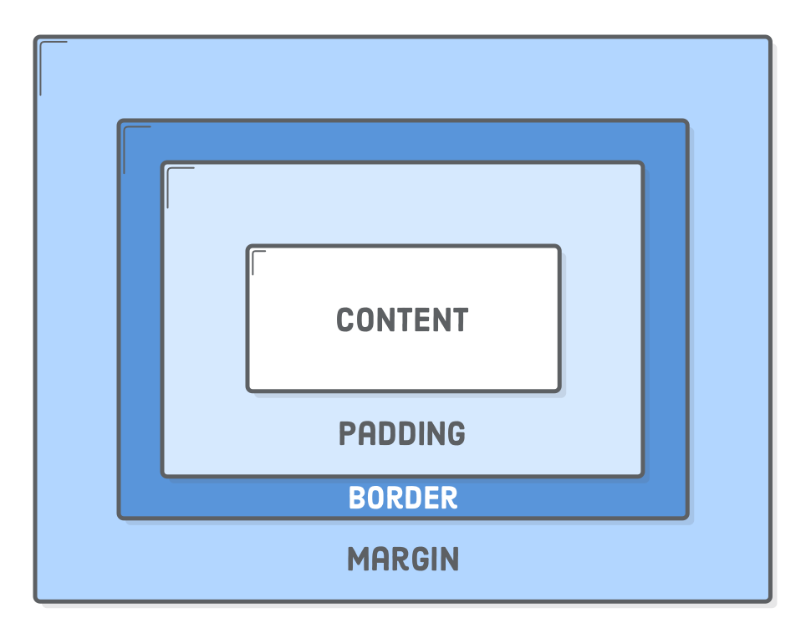
Box Model

Slide 18
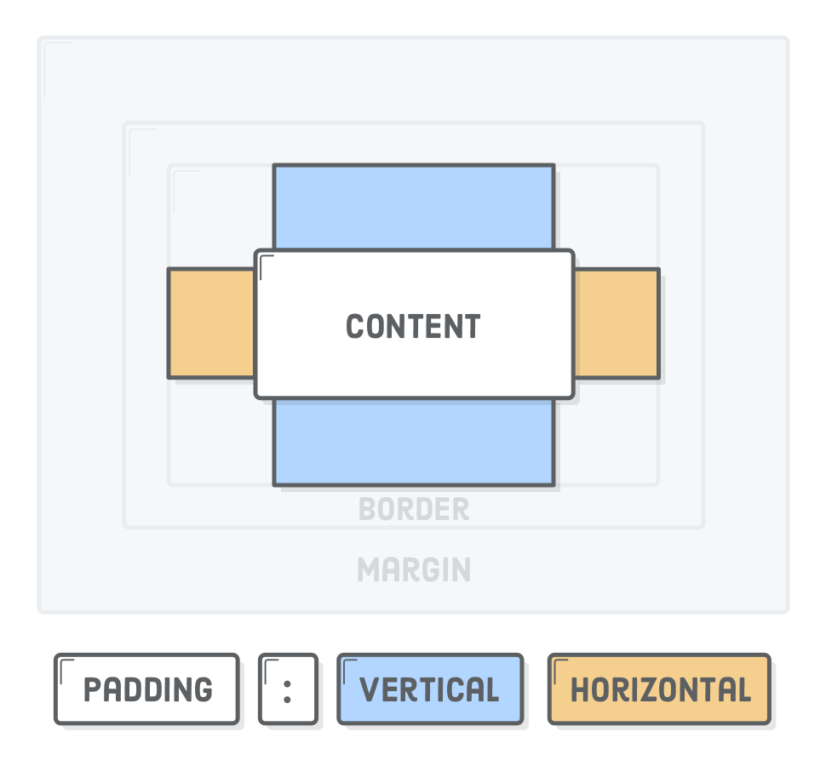
Padding
h1 {padding-top: 20px; }
h1 {padding-bottom: 20px; }
h1 {padding-right: 20px; }
h1 {padding-left: 20px; }
h1 {padding: 20px; }
h1 {padding-left: 20px 10px; }
https://www.w3schools.com/css/css_padding.asp

Slide 19
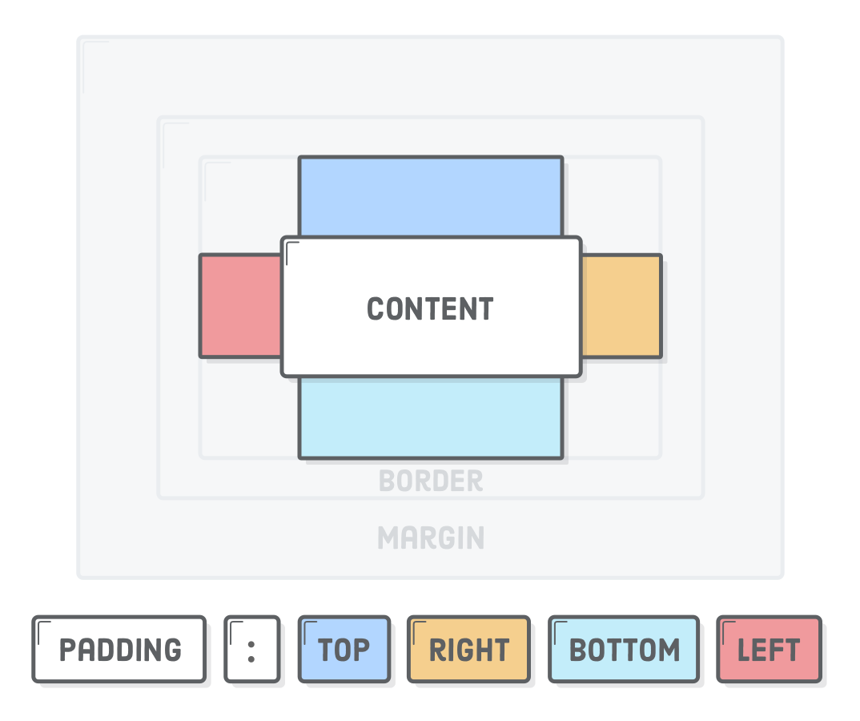
Shorthand
h1 {padding: 10px 20px 0px 5px; }
https://www.w3schools.com/css/css_padding.asp

Slide 20
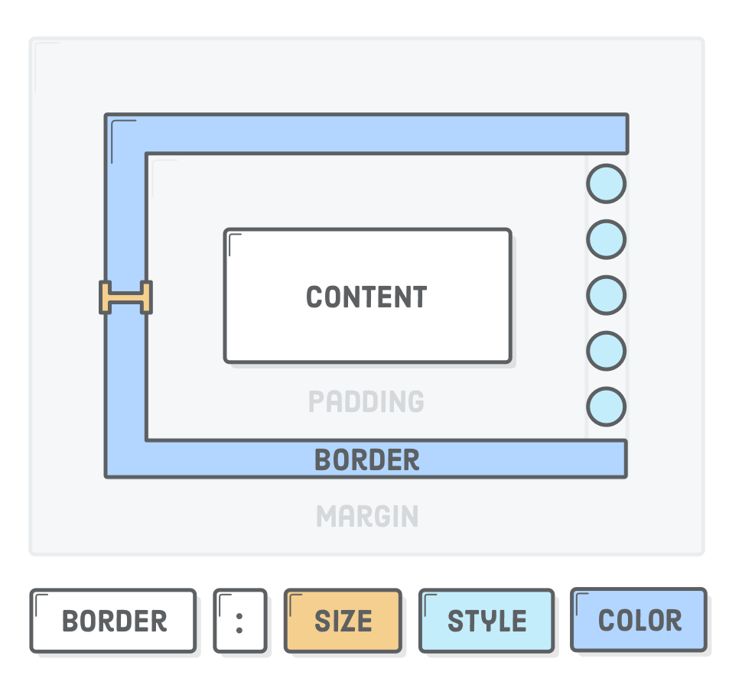
Border
h1 {border-width: 2px; }
h1 {border-style: solid; }
h1 {border-color: blue; }
h1 {border: 2px solid blue; }
h1 {border-radius: 5px; }
h1 {border-bottom-left-radius: 5px; }
h1 {border-bottom-radius: 5px; }
h1 {border-bottom-color: 5px; }
https://www.w3schools.com/css/css_border.asp

Slide 21
Margin
h1 {margin-top: 20px; }
h1 {margin-bottom: 20px; }
h1 {margin: 20px 10px; }
h1 {margin: 20px 10px 0px 5px; }
https://www.w3schools.com/css/css_margin.asp

Slide 22
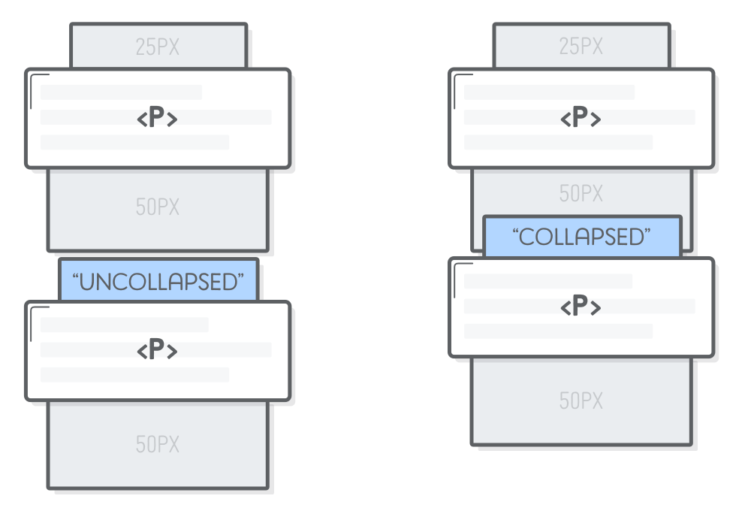
Vertical margin collapse
only the biggest one is displayed

Slide 23
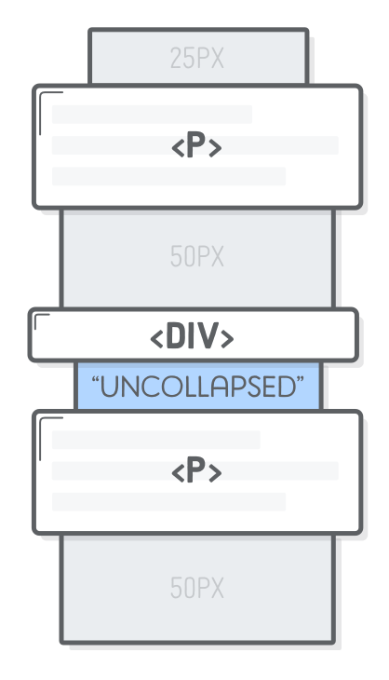
Prevent margin collapse
<p>Paragraph </p>
<div style='padding-top: 1px'></div> <!-- Add this -->
<p> Paragraphs</p>
https://developer.mozilla.org/en-US/docs/Web/CSS/CSS_Box_Model/Mastering_margin_collapsing

Slide 24
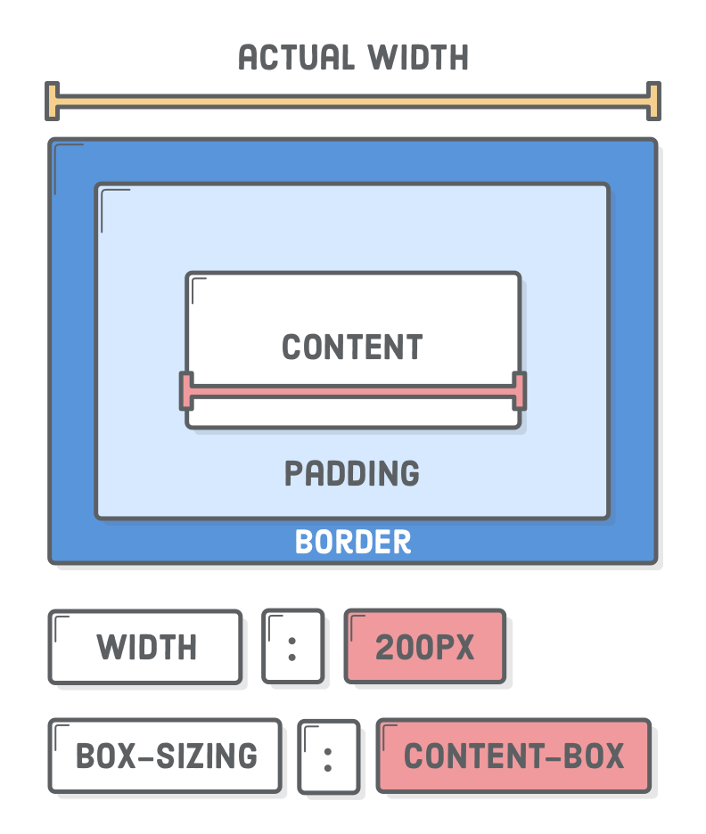
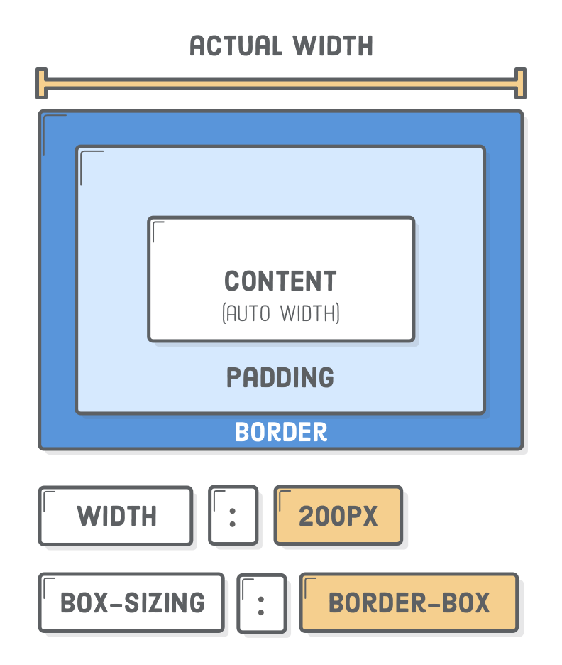
Content Box - Border Box
https://www.w3schools.com/css/css_margin.asp

Slide 25
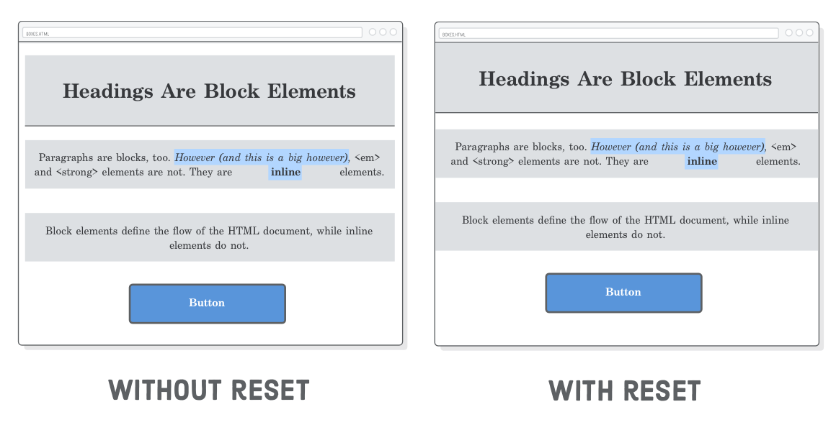
Resetting styles
* { margin: 0;
padding: 0;
box-sizing:
border-box; }

Slide 26
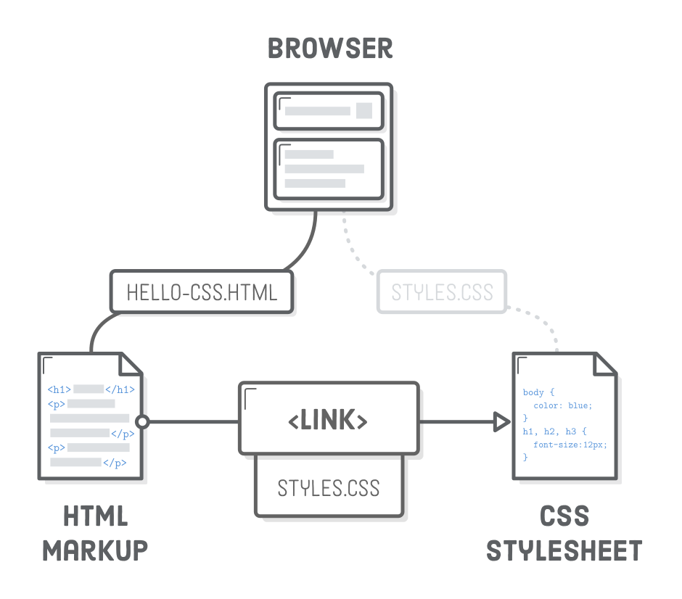
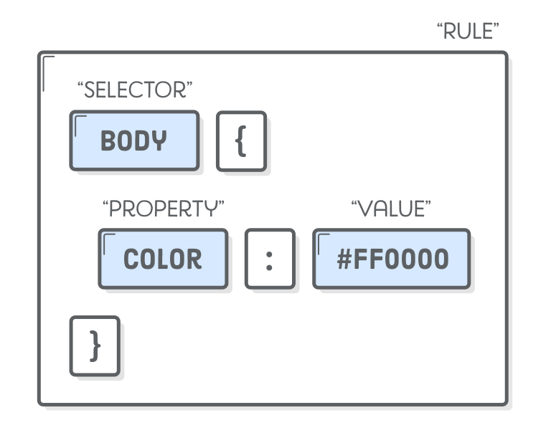
CSS Selectors

Slide 27
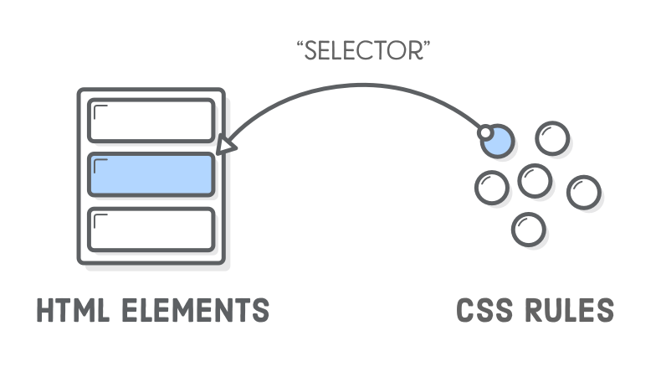
CSS selectors

Slide 28
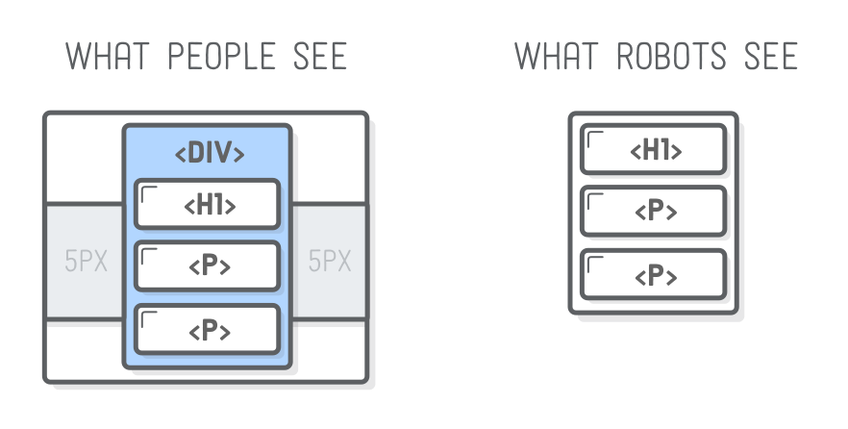
Use <div>s for styling and structuring
<div class=“container”>
<h1>title</h1>
<p>text</p>
<p>text</p>
</div>

Slide 29
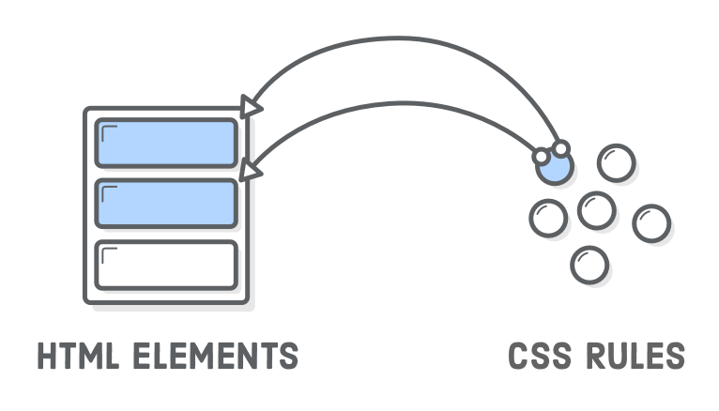
CSS rules are Reusable
<div class='button'>Button One</div>
<div class='button'>Button Two</div>

Slide 30
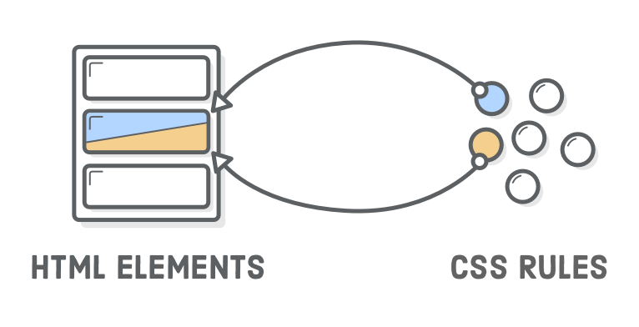
One html element takes
more than one CSS rule
Order doesn’t matter in html / but do in css
<div class='button red'>Button One</div>
<div class=‘red button'>Button Two</div>

Slide 31
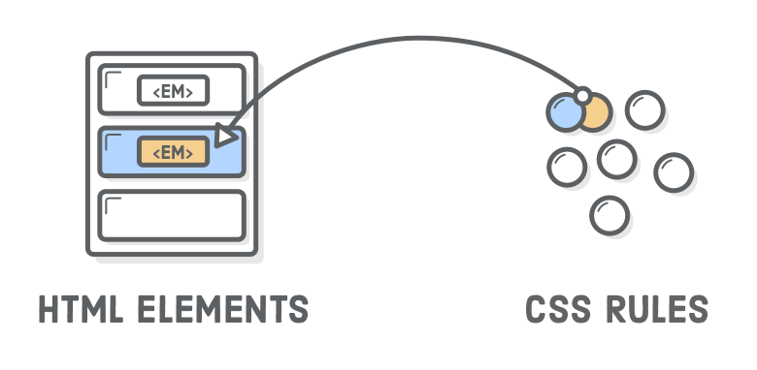
Descendant selectors
<h1> here is <em>text</em> about..</h1>
H1 em {
Font-size: 1em
}

Slide 32
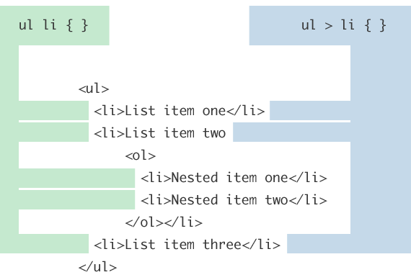
Child Combinator

Slide 33
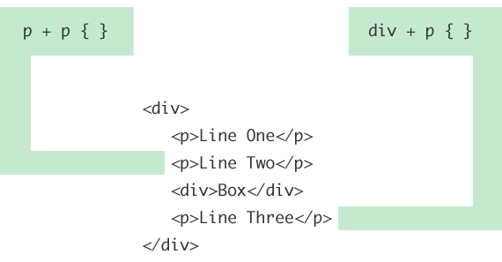
Adjacent Sibling Combinator

Slide 34
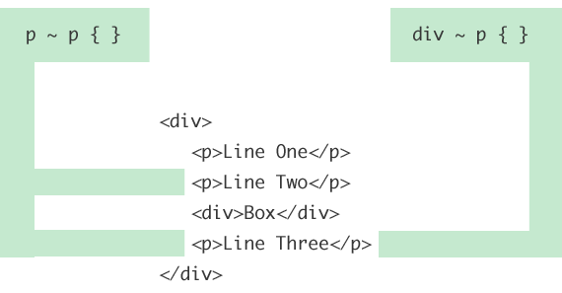
General Sibling Combinator

Slide 35
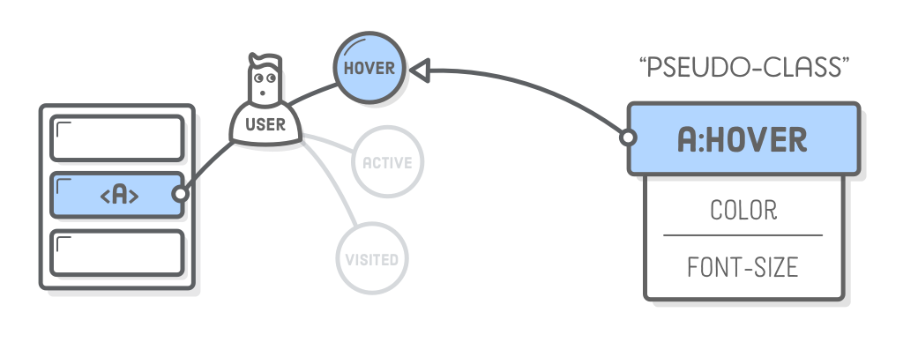
Pseudo-classes for links
:link – A link the user has never visited.
:visited – A link the user has visited before.
:hover – A link with the user’s mouse over it.
:active – A link that’s being pressed down by a mouse (or finger).
a:visited:hover { color: orange; }
a:hover { color: orange; }

Slide 36
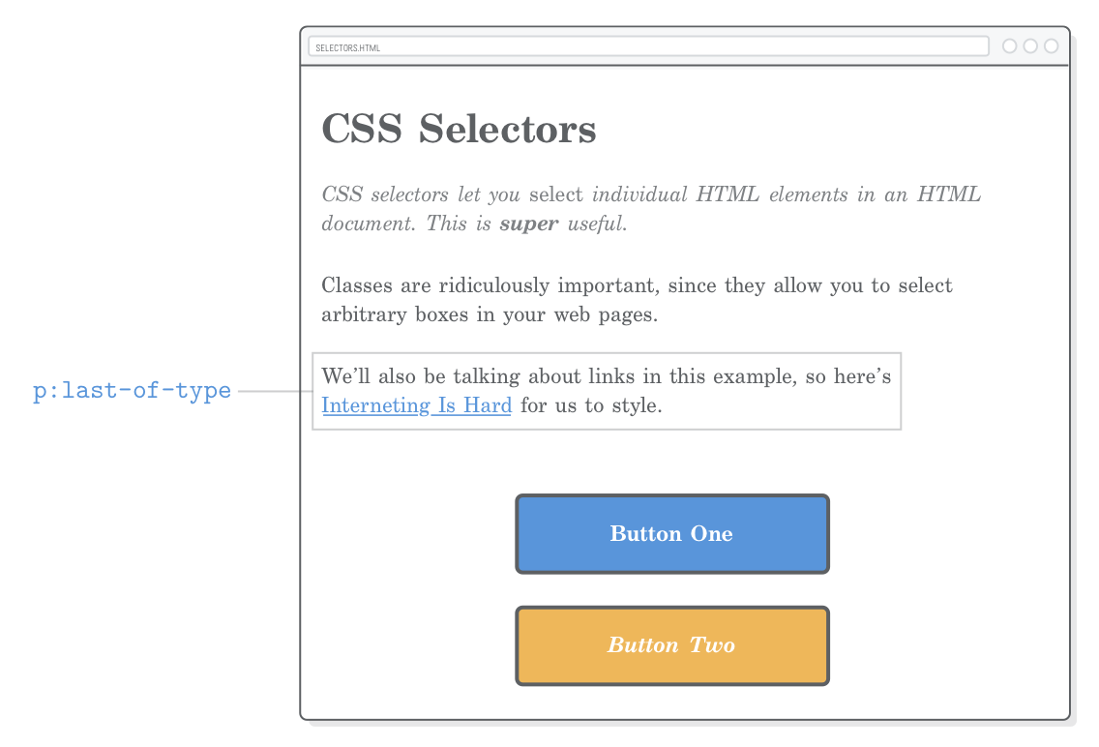
Pseudo-classes for structure
p:last-of-type { margin-bottom: 50px; }
p:first-of-type { color: #7E8184; font-style: italic; }
.page > p:first-of-type {
color: #7E8184;
font-style: italic;
}

Slide 37
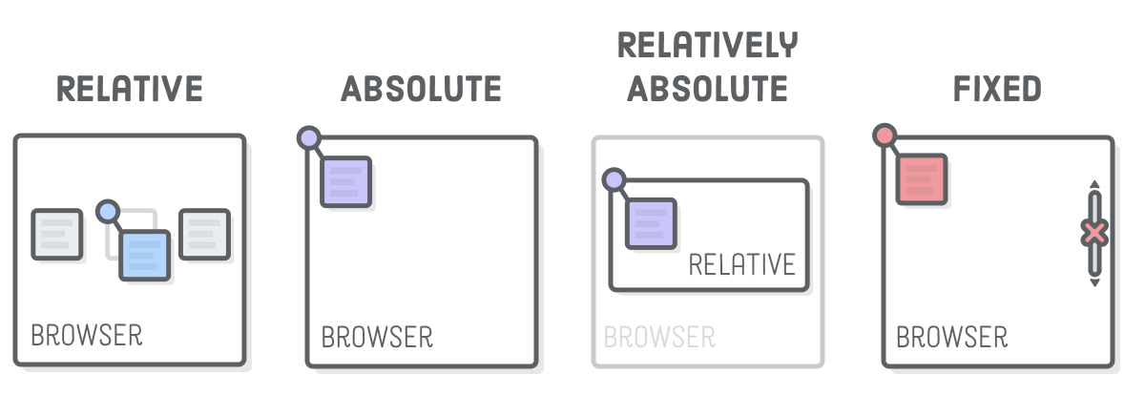
CSS Position

Slide 38
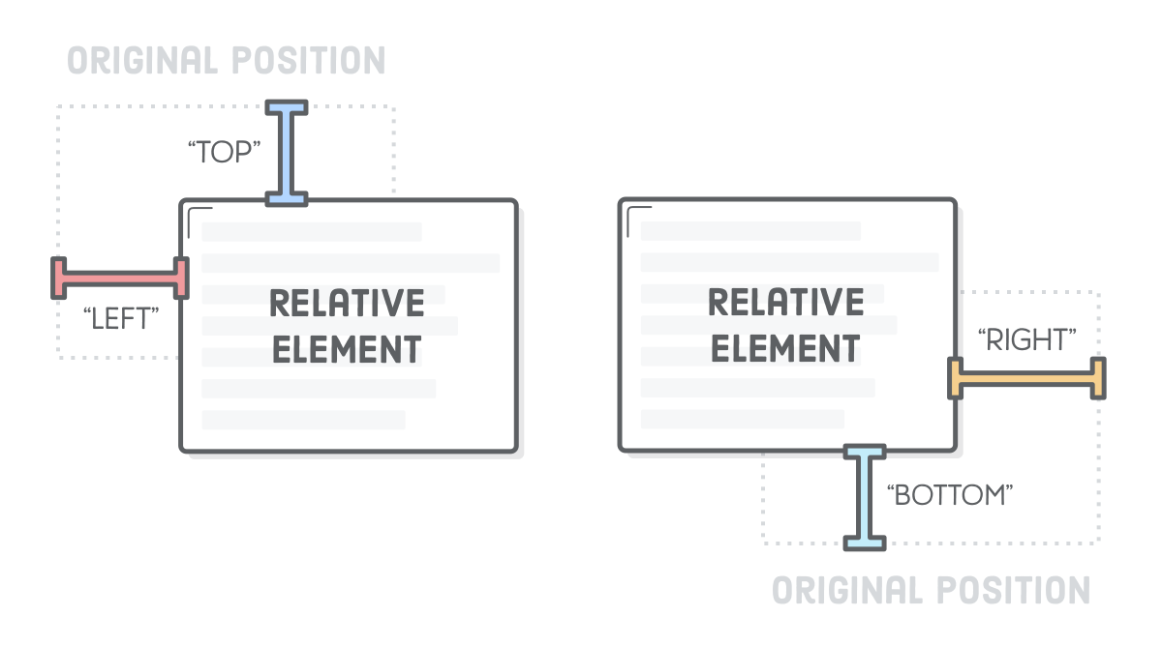
Elements around relative stay where they would normally appear
top and left properties let you define how far it’s offset from its original static position
Relative positioning works similarly to margins without effecting the surrounding elements
The top and left properties measure from the original box’s top and left edges, respectively
Relative position

Slide 39
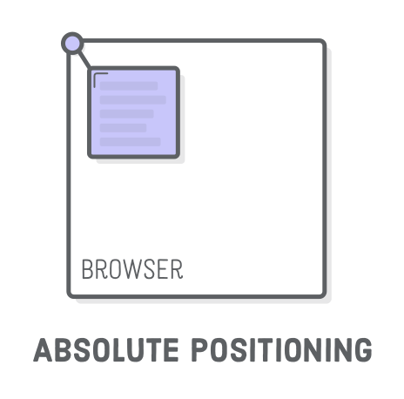
Absolute position
like relative positioning, but the offset is relative to the entire browser window
it completely removes an element from the normal flow of the page

Slide 40
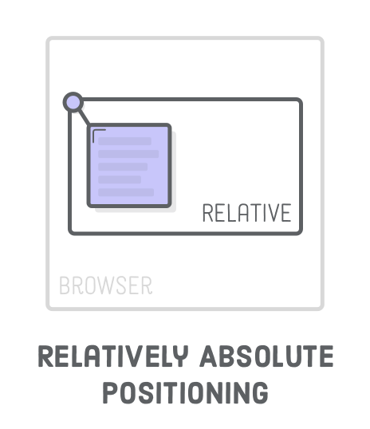
Relatively
Absolute position
Coordinates for absolute elements are always relative to the closest container that is a positioned element (relative parent)

Slide 41
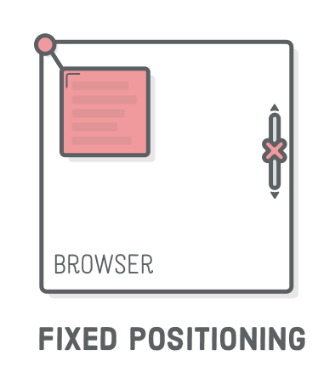
Fixed position
fixed elements don’t scroll with the rest of the page
the element is removed from the normal flow of the page (like absolute position)
the coordinate system is relative to the entire browser window

Slide 42
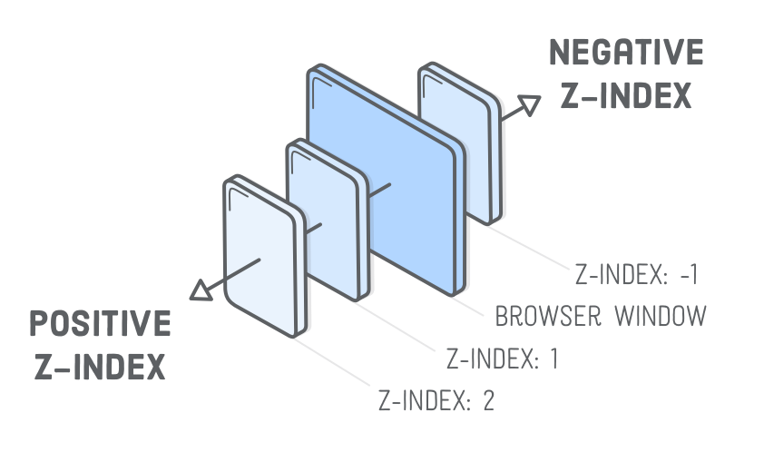
Z-index

Slide 43
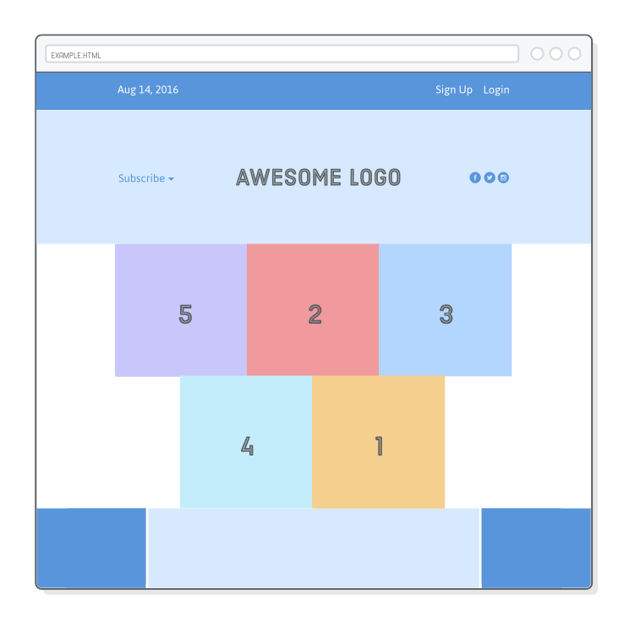
FLEXBOX
.menu-container {
display: flex;
}

Slide 44
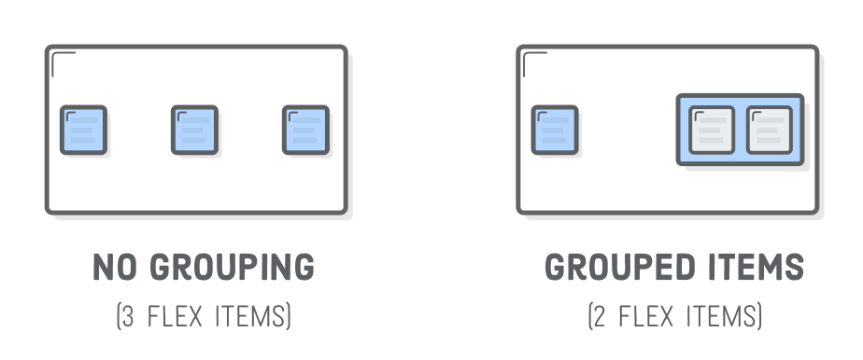
Manipulate HTML for Flexbox
<div class='menu’>
<p class='date'>Aug 14, 2016</p>
<div class='links’>
<a class='signup'>Sign Up</a>
<a class='login'>Login</a>
</div>
</div>
<div class='menu’>
<p class='date'>Aug 14, 2016</p>
<a class='signup'>Sign Up</a>
<a class='login'>Login</a>
</div>

Slide 45
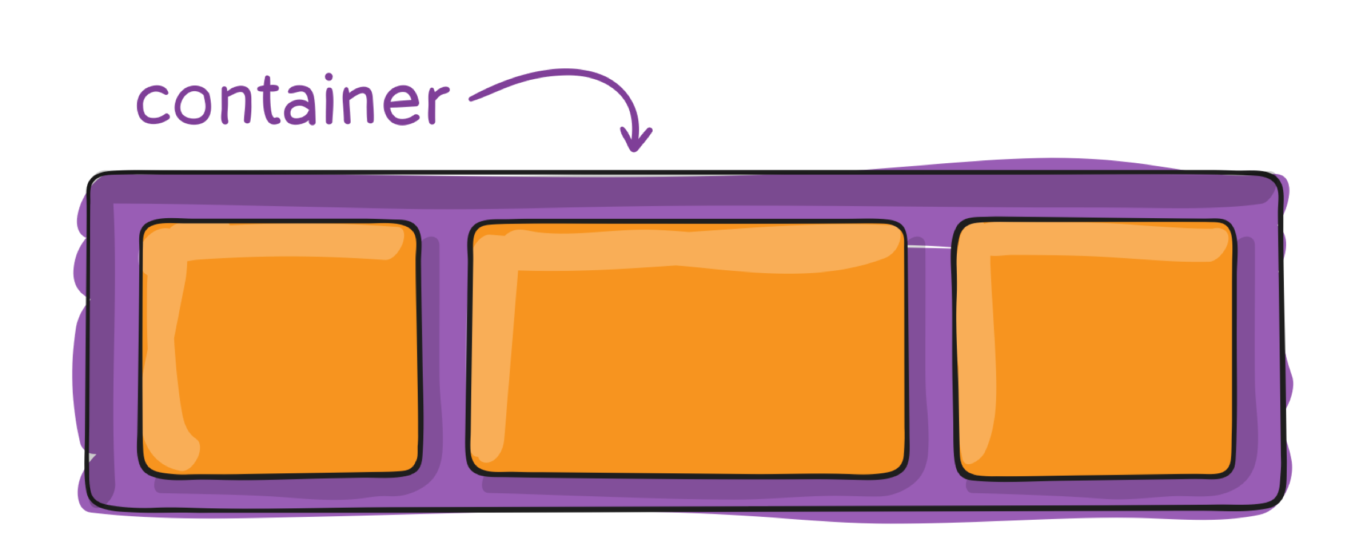
Properties for the Parent
.container { display: flex; }

Slide 46
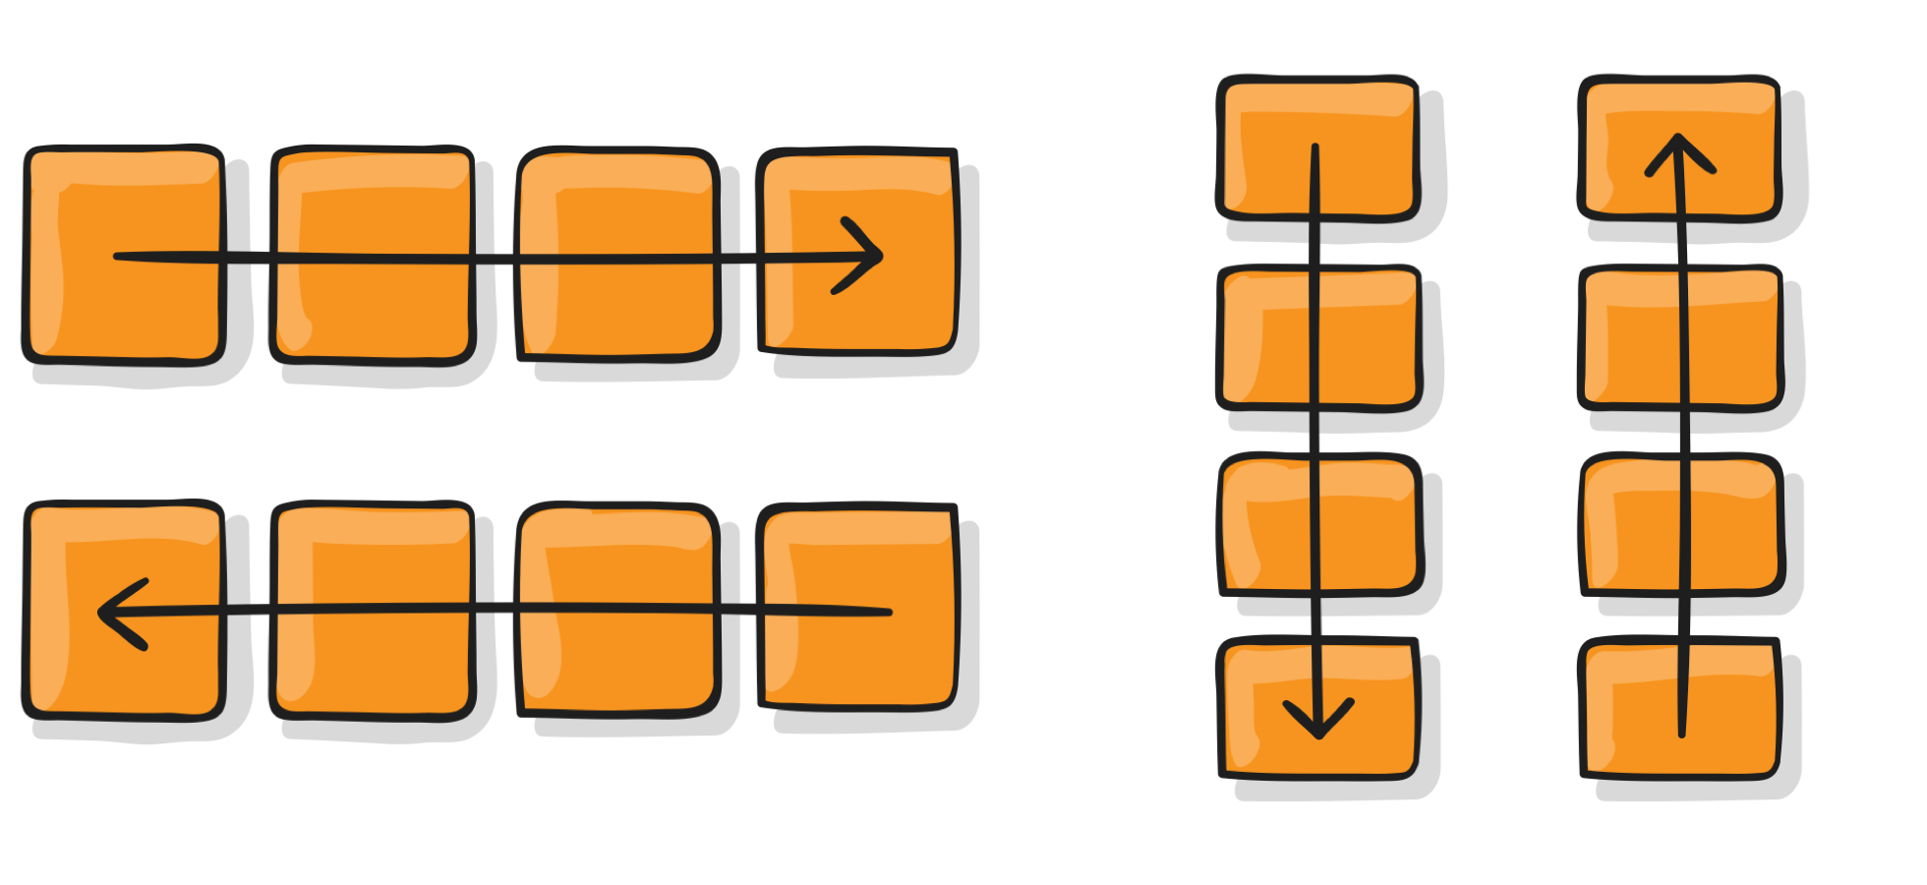
flex-direction
This establishes the main-axis
row (default): left to right in ltr; right to left in rtl
row-reverse: right to left in ltr; left to right in rtl
column: same as row but top to bottom
column-reverse: same as row-reverse but bottom to top
.container { flex-direction: row | row-reverse | column | column-reverse; }

Slide 47
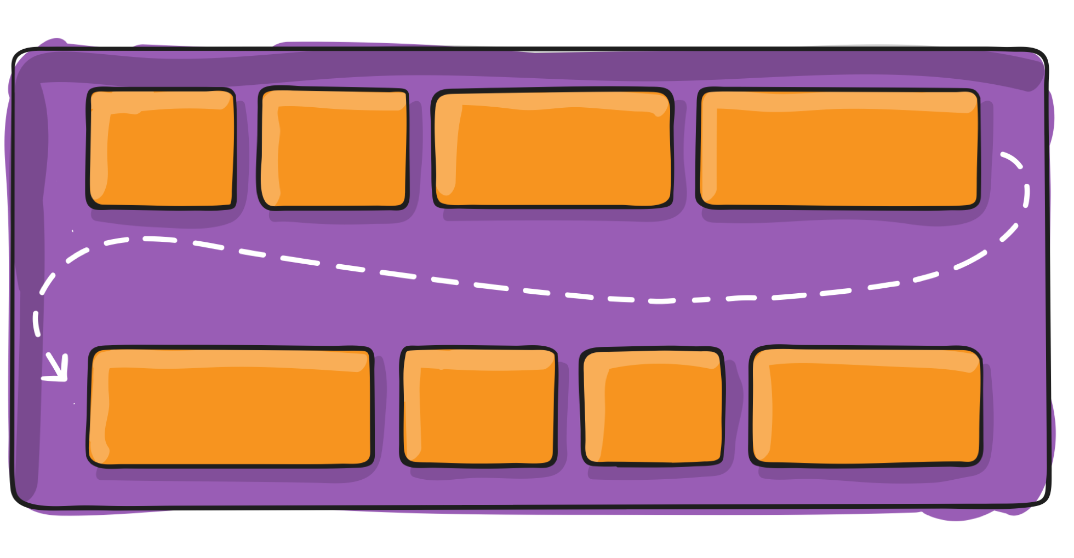
flex-wrap
By default, flex items will all try to fit onto one line. You can change that and allow the items to wrap as needed with this property.
nowrap (default): all flex items will be on one line
wrap: flex items will wrap onto multiple lines, from top to bottom.
wrap-reverse: flex items will wrap onto multiple lines from bottom to top.
.container {flex-wrap: nowrap | wrap | wrap-reverse; }

Slide 48
flex-flow
This is a shorthand flex-direction and flex-wrap properties, which together define the flex container's main and cross axes. Default is row nowrap.
.container {flex-flow: <‘flex-direction’> || <‘flex-wrap’>; }

Slide 49
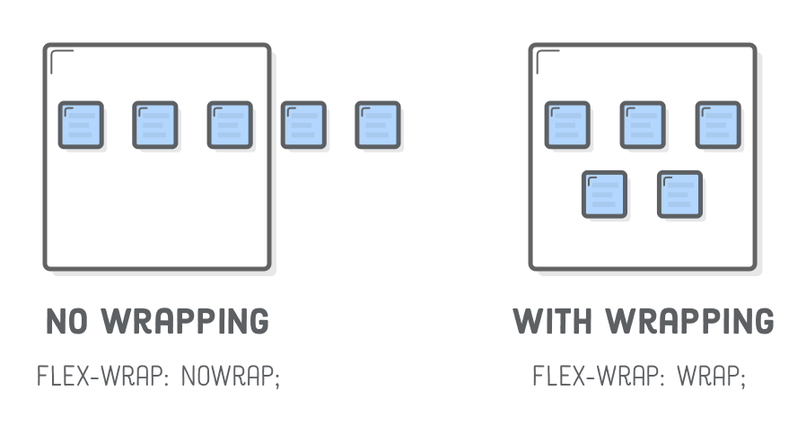
Wrapping elements
.photo-grid {
flex-wrap: nowrap;
}
.photo-grid {
flex-wrap: wrap;
}

Slide 50
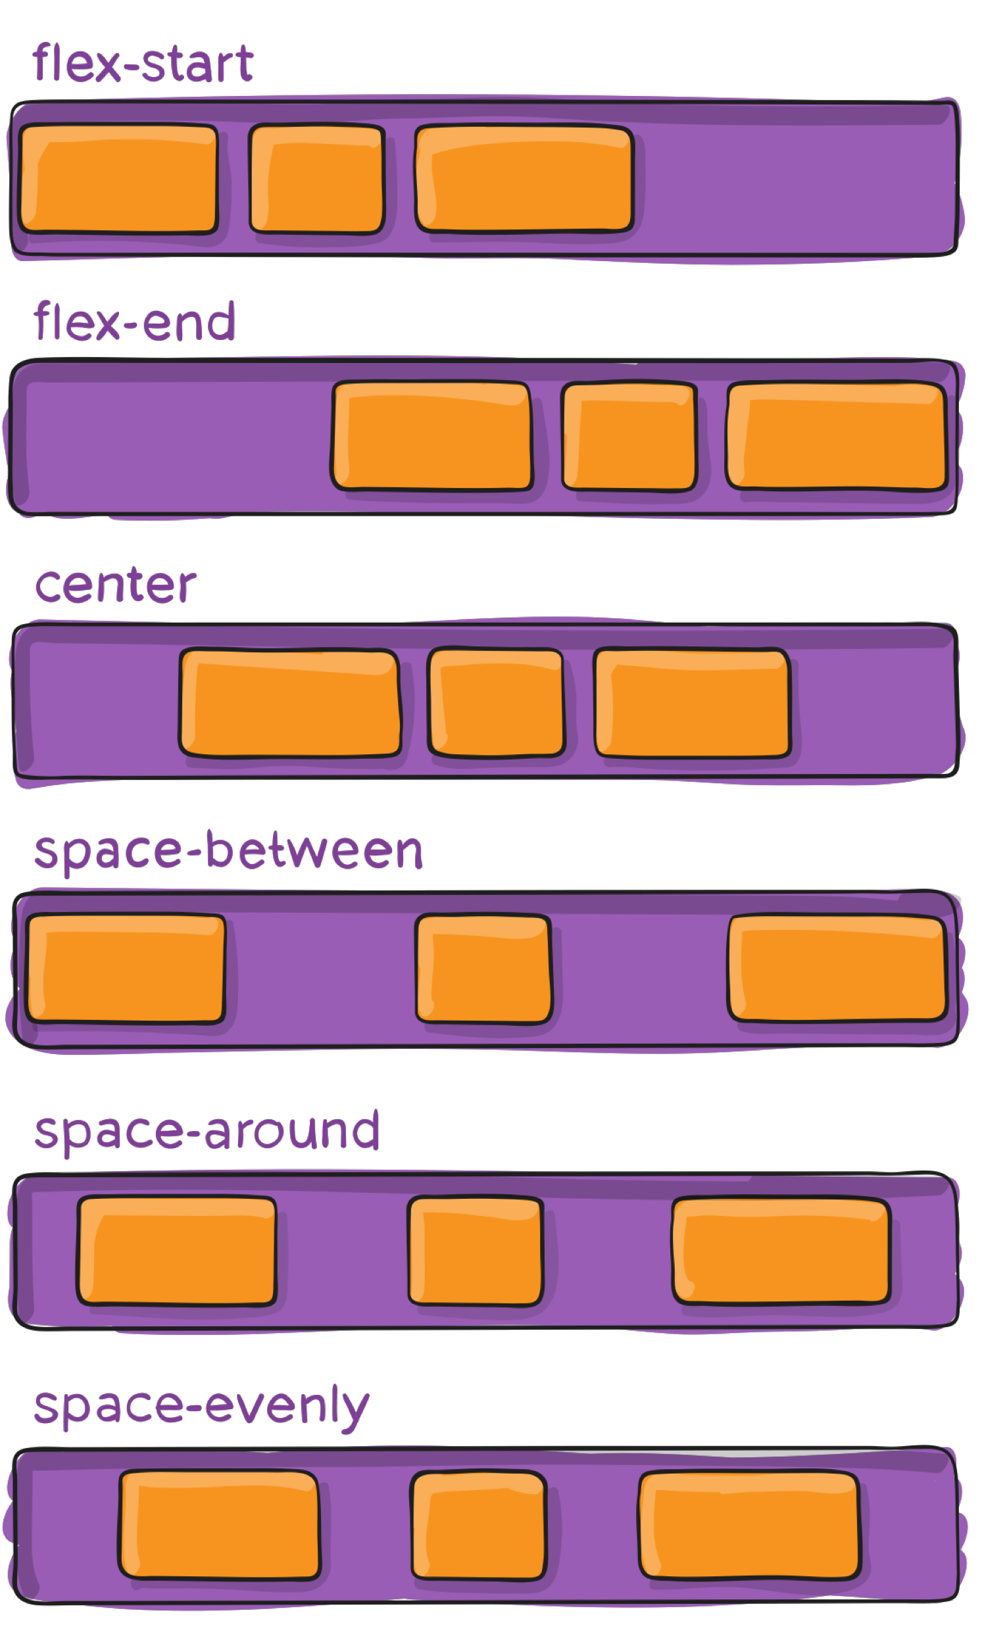
justify-content
This defines the alignment along the main axis
flex-start (default): items are packed toward the start line
flex-end: items are packed toward to end line
center: items are centered along the line
space-between: items are evenly distributed in the line; first item is on the start line, last item on the end line
space-around: items are evenly distributed in the line with equal space around them. Note that visually the spaces aren't equal, since all the items have equal space on both sides. The first item will have one unit of space against the container edge, but two units of space between the next item because that next item has its own spacing that applies.
space-evenly: items are distributed so that the spacing between any two items (and the space to the edges) is equal.
.container {justify-content: flex-start | flex-end | center | space-between | space-around | space-evenly; }

Slide 51
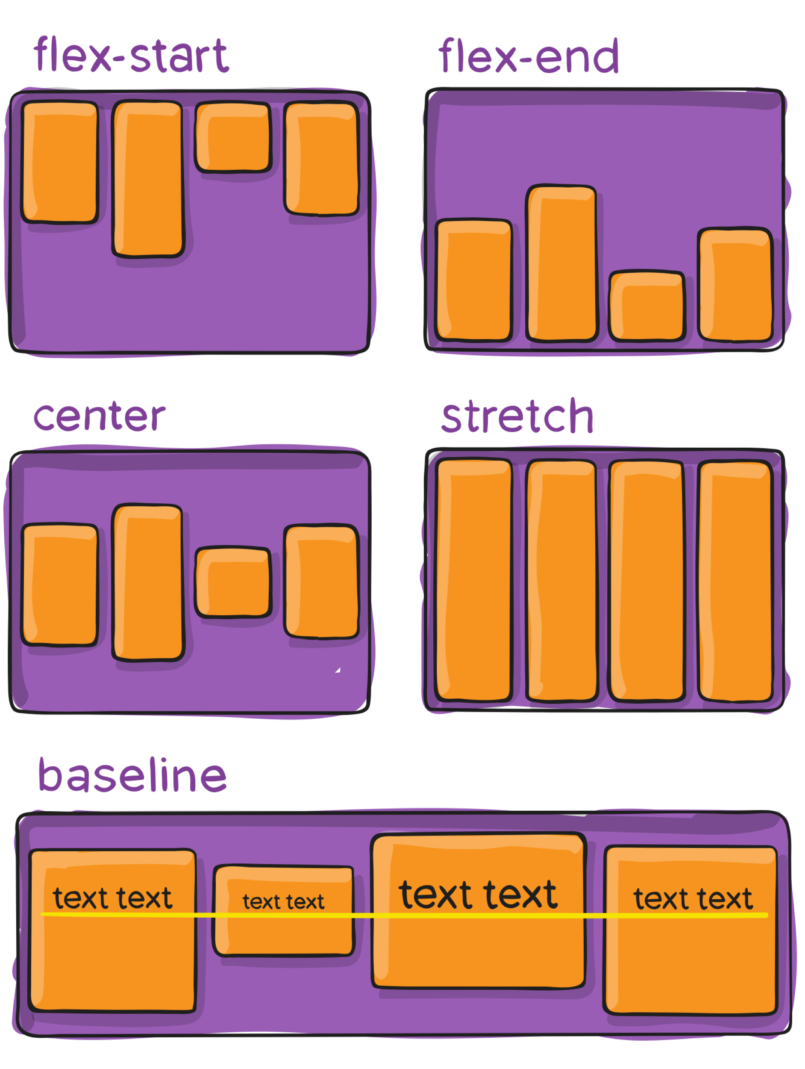
align-items
Think of it as the justify-content version for the cross-axis
stretch (default): stretch to fill the container (still respect min-width/max-width)
flex-start: cross-start margin edge of the items is placed on the cross-start line
flex-end: cross-end margin edge of the items is placed on the cross-end line
center: items are centered in the cross-axis
baseline: items are aligned such as their baselines align
.container {align-items: stretch | flex-start | flex-end | center | baseline; }

Slide 52
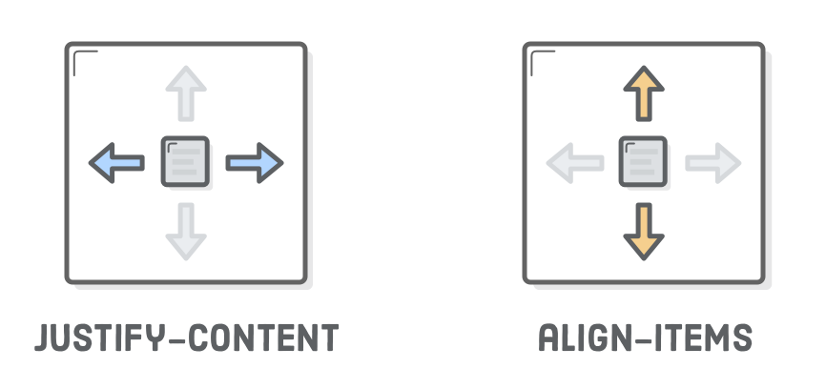
Manipulate HTML for Flexbox
.menu-container {
display: flex;
justify-content: center
}
.menu-container {
display: flex;
align-items: center
}
center
flex-start
flex-end
space-around
space-between
center
flex-start (top)
flex-end (bottom)
stretch
baseline

Slide 53

Properties for the Item
.container { display: flex; }

Slide 54

Order
By default, flex items are laid out in the source order. However, the order property controls the order in which they appear in the flex container.
.item { order: <number>;} /* default is 0 */

Slide 55


flex-grow
This defines the ability for a flex item to grow if necessary
.item { flex-grow: <number>;} /* default is 0 */

Slide 56

flex-shrink
This defines the ability for a flex item to shrink if necessary.
.item { flex-shrink: <number>;} /* default is 1 */

Slide 57

flex-basis
This defines the default size of an element before the remaining space is distributed
20%, 5rem, etc
.item { flex-basis: <length> | auto;} /* default is auto */

Slide 58


flex-basis

Slide 59

align-self
This allows the default alignment (or the one specified by align-items) to be overridden for individual flex items.
.item { align-self: auto | flex-start | flex-end | center | baseline | stretch;}

Slide 60

Flexbox
.menu-container {
display: flex;
flex-direction: row;
flex-wrap: nowrap;
}

Slide 61

Flex container direction
.menu-container {
display: flex;
flex-direction: row;
flex-wrap: wrap;
}

Slide 62

Flex container direction
.menu-container {
display: flex;
flex-direction: column;
}

Slide 63

Direction - align-elements – justify-content
.menu-container {
display: flex;
flex-direction: column;
align-items: center
}

Slide 64

Flexible Items
flex: 1
flex: 1
flex: 1
flex: 2

Slide 65

Static items widths
width: 300px
flex: 1
width: 300px

Slide 66
Everything is a box
Use display: flex; to create a flex container.
Use justify-content to define the horizontal alignment of items.
Use align-items to define the vertical alignment of items.
Use flex-direction if you need columns instead of rows.
Use the row-reverse or column-reverse values to flip item order.
Use order to customize the order of individual elements.
Use align-self to vertically align individual items.
Use flex to create flexible boxes that can stretch and shrink.

Slide 67

Responsive Design
https://www.w3schools.com/html/html_responsive.asp

Slide 68

Mobile internet usage has surpassed desktop usage in 2016.

Slide 69

Time spent

Slide 70
px
CSS units
the size of one pixel on the screen
good at spacing and layout but are not good fit for font-size
em
<html> is the parent of <head> and <body>
<head> is the first child of <html>
<body> is the last child of <html>
equal to the computed font-size of that element’s parent
<div font-size=16px> so 1em=16px
If font-size is not defined, it will inherit it from the parent
rem
rem values are relative to the root html element
Usually default font-size of the browser is 16px
if font-size: 62.5% - so 16px is 10px and 1rem = 10px and 1px = 0.1rem
%

Slide 71


Without the viewport meta tag:
With the viewport meta tag:
HTML meta tag
<img src="img_girl.jpg" style="width:100%;">

Slide 72

Media Query
<meta name="viewport" content="width=device-width, initial-scale=1" />

Slide 73


Media Query

Slide 74


Slide 75
Thanks!
HackYourFuture

